Slide 1

SMARTEDU+: ADVANCED MACHINE LEARNING SYSTEM FOR EARLY PREDICTION OF STUDENT DROPOUTS
Team Member: 1. Mohanapoorani R (2023PECCS277)
2. Mamtha J (2023PECCS266)
Guide: Dr.Valarmathi K
Coordinator: Dr.K.Valarmathi , Dr.K.Sangeetha
Department: Computer Science & Engineering
Domain: Data Science & Machine Learning
Batch No: C12
SDG Goal: SDG 4 – Quality Education
Target 4.1: Ensure free, equitable, and quality education for all

Slide 2
BASE PAPER DETAILS
Title: An Investigation Into Dropout Indicators in Secondary Technical Education Using Explainable Artificial Intelligence
Author(s): D.F. Silva et al.
Journal/Conference: IEEE Revista Iberoamericana de Tecnologias del Aprendizaje
Year: May 2025
Publisher: IEEE
Summary:
Explores dropout indicators using Explainable AI (LIME, SHAP).
Focused on academic, behavioral, and socio-economic factors in secondary technical education.

Slide 3
ABSTRACT
Problem Statement:
Student dropouts significantly affect educational equity in India.
Current detection methods are reactive, not predictive.
Lack of early-warning systems in schools.
Objectives:
Predict student dropout risk early using ML.
Provide explainable insights via SHAP for transparency.
Enable timely intervention for at-risk students.
Significance:
Contributes to SDG 4 goals.
Supports data-driven decision-making in education.

Slide 4
SOCIAL RELEVANCE
How it Benefits Society:
Reduces dropout rates by early identification of at-risk students.
Ensures continuous education for underprivileged students.
Link to UN SDGs:
Directly supports SDG 4 – Quality Education.
Helps achieve Target 4.1.
Importance in Solving Real-world Problems:
Addresses educational inequality.
Improves retention and performance of students nationwide.

Slide 5
INTRODUCTION
Background:
Dropout rates in India (UDISE+ 2021–22): Secondary school dropout rate is 12.6%.
Most interventions happen after dropout, reducing effectiveness.
Motivation:
Need for proactive solutions using AI/ML.
Integrating explainable AI ensures educators trust the system.

Slide 6
LITERATURE SURVEY
YEAR | AUTHORS | TITLE / FOCUS | TECHNICAL USED | KEY OUTCOME
2010 | Romero & Ventura | Educational data mining survey | EDM methods | Research base
2016 | Aulck et al. | Early dropout ID | Demographic, Transcript, ML | Early intervention
2019 | Willms & Tramonte | SES & dropout | SES indicators | SES predicts dropout
2019 | Orooji & Chen | Imbalanced learning | Sampling techniques | Better recall
2020 | PMC | RF & SVM across schools | RF, SVM | Performance varies
2021 | Park & Yoo | Online dropout via LMS | LMS logs, RF | Early online ID
2021 | Yihun & Šimonová | Global dropout model | ML | Global issue tackled
2021 | Fernandez Garcia | Ensemble models | Ensemble ML | Higher accuracy
2023 | Tomori & Tomori | Adult learner dropout | Decision Tree | ~80% accuracy
2024 | Benlachmi et al. | RF vs Naïve Bayes | RF, NB | RF 100%, NB close
2025 | Cheng et al. | Dual-modal dropout detection | Behavioral + Academic | Better detection
2025 | Elbouknify et al. | SHAP-based at-risk detection | SHAP (XAI) | 88% accuracy
NA | MDPI | SHAP/LIME factors | SHAP, LIME | SES, attendance key
NA | MDPI | LightGBM study | LightGBM | ~95% accuracy
NA | RG & Wikipedia | Predictors & inequality | LR, SVM, SES | GPA, income, gender

Slide 7
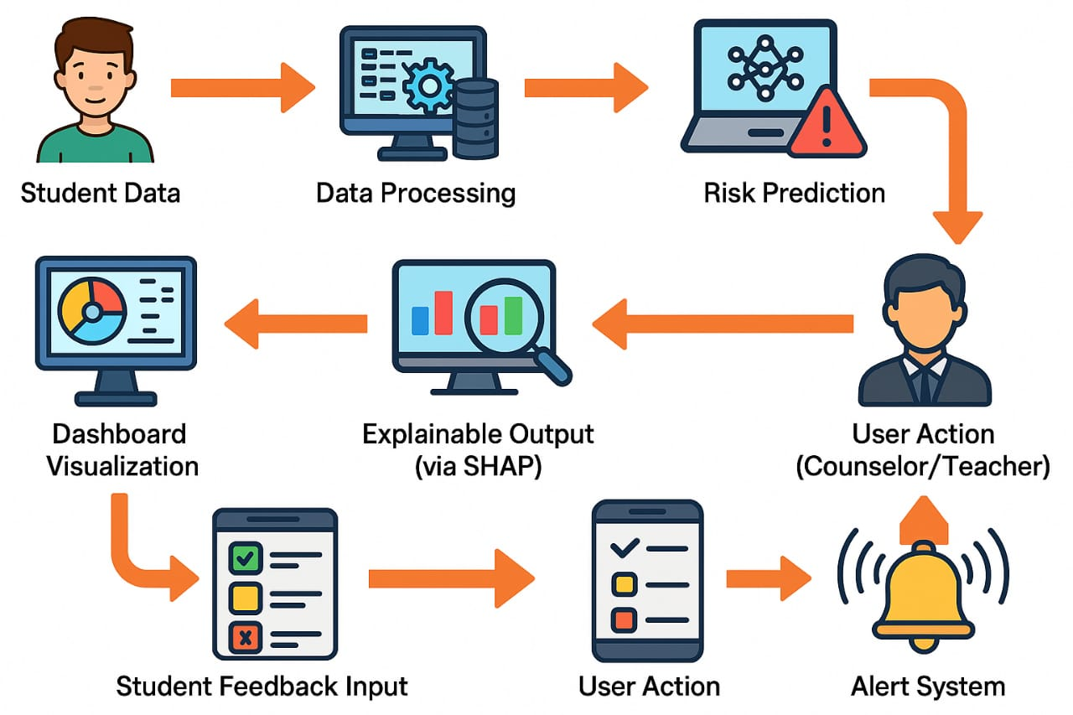
ARCHITECTURE DIAGRAM

Slide 8
HARDWARE/SOFTWARE SPECIFICATIONS
Hardware
Processor: Intel Core i5 / i7 or AMD Ryzen 5 / 7 (or higher)
RAM: Minimum 8 GB
Storage: Minimum 256 GB SSD
Graphics: Integrated or Dedicated GPU
Display: 1080p resolution or higher
Software & Tools
Programming Language: Python 3.9+
Libraries: Pandas, NumPy, Scikit-learn, XGBoost, SHAP, Matplotlib, Seaborn
Framework: Streamlit for interactive dashboards
IDE/Editor: VS Code, Jupyter Notebook, PyCharm
Database: MySQL / SQLite
OS: Windows 10/11 or Linux
Others: Anaconda environment for package management

Slide 9
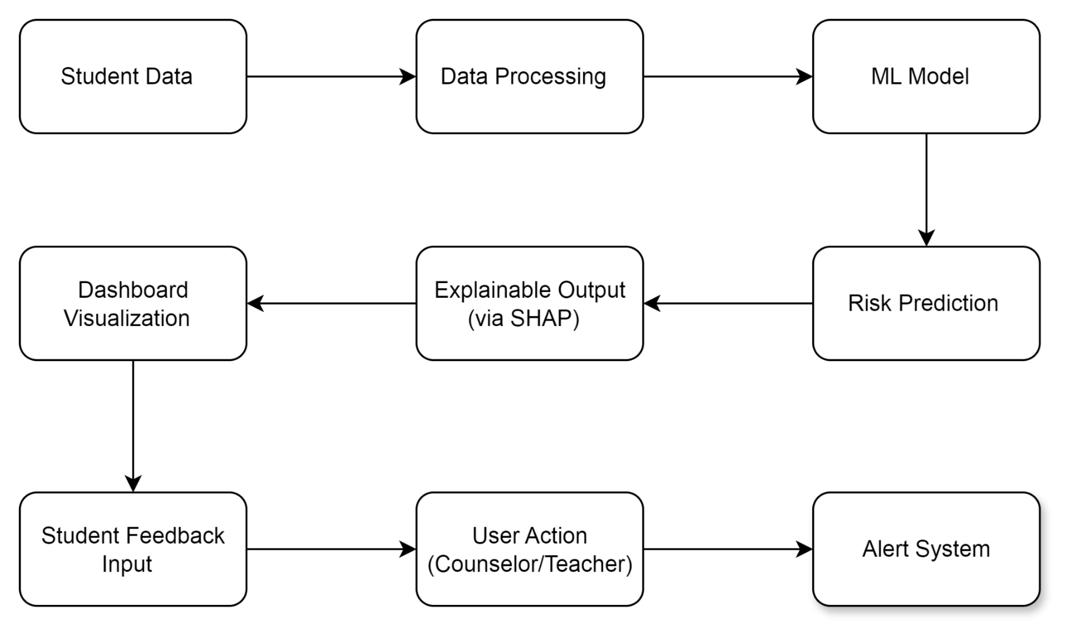
DATA FLOW DIAGRAM/SYSTEM ARCHITECTURE

Slide 10
MODULES EXPLAINATION
Functional Description of Each Module
Data Collection – Collects academic, attendance, socio-economic, and behavioral data from school DBs, forms, CSVs.
Preprocessing – Cleans data, encodes categories, splits into train/test sets.
Model Training – Trains XGBoost with hyperparameter tuning & balanced data.
SHAP Analysis – Explains predictions, highlights key dropout factors.
Prediction – Streamlit form takes inputs, applies encoders, predicts High/Low risk.
Dashboard – Shows results, feature importance, and visual reports and risk-alerts.

Slide 11
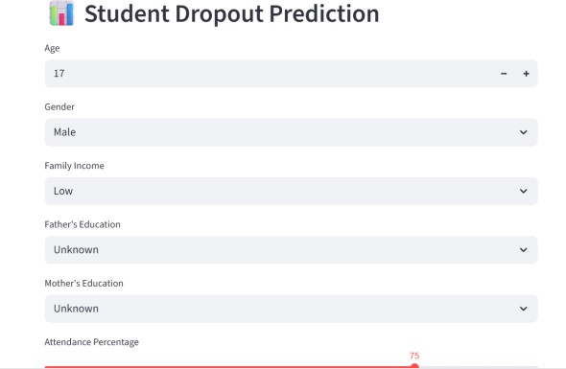
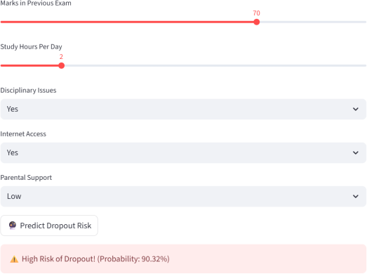
OUTCOME
Fig.1 Dropout Risk Distribution Dashboard

Slide 12
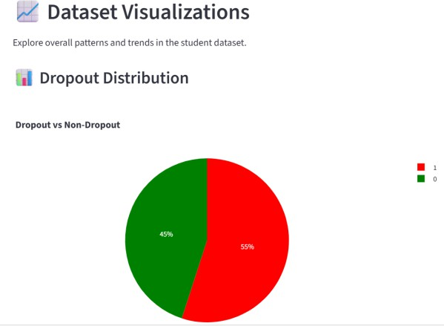
DATA VISUALIZATIONS/SCREENSHOTS
Fig 2. Dropout Prediction

Slide 13
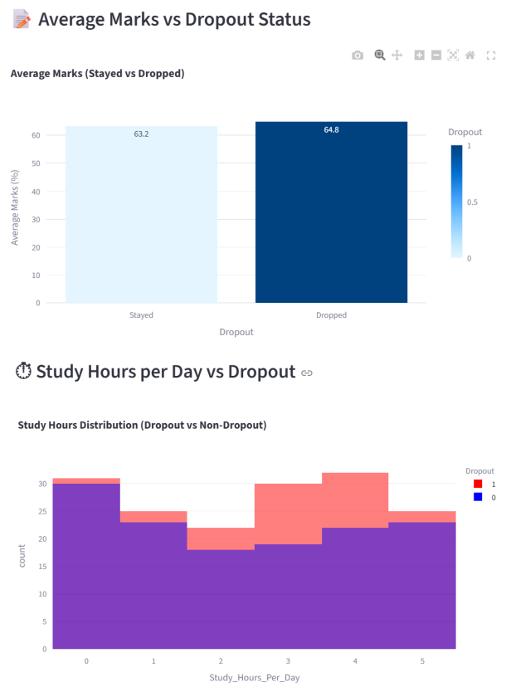
AVERAGE MARKS VS DROUPOUT RATE

Slide 14
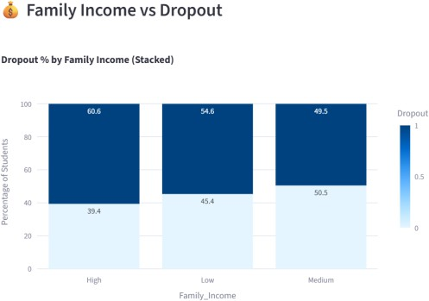
FAMILY INCOME VS DROPOUT
Fig. 3. Charts Showing Dropout Risk Distribution Across Students

Slide 15
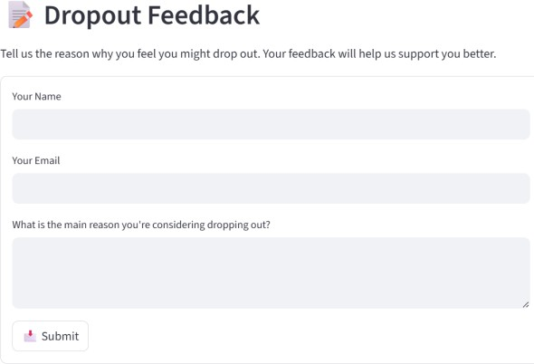
DROPOUT FEEDBACK
Fig 4. Student Dropout Feedback Collection Module

Slide 16
CONCLUSION & FUTURE SCOPE
Conclusion
Built an XGBoost + SHAP-based model for student dropout prediction.
Identified key risk factors for early intervention.
SHAP Ensures transparency and trust through explainable AI.
Future Scope
Add interactive dashboard & real-time alerts.
Expand dataset for better accuracy.
Include more student performance and behavioral features.

Slide 17
REFERENCES
J. Cheng et al., “Predicting Student Dropout Risk With A Dual-Modal Abrupt Behavioral Changes Approach,” arXiv, 2025.
I. Elbouknify et al., “AI-based Identification and Support of At-Risk Students: Moroccan Case Study,” arXiv, 2025.
L. Aulck et al., “Predicting Student Dropout in Higher Education,” arXiv, 2016.
M. Orooji and J. Chen, “Predicting Louisiana Public High School Dropout through Imbalanced Learning Techniques,” arXiv, 2019.
H. S. Park and S. J. Yoo, “Early Dropout Prediction in Online Learning,” ResearchGate, 2021.
A. J. Fernandez Garcia et al., “Real-Life ML Experience for Predicting University Dropout,” ResearchGate, 2021.

Slide 18
Thank you

